Slide 1
GPA Explanation
Notes:
Hello everyone, in this presentation we will discuss how IEP students can calculate their grade point average.

Slide 2
IEP Grading System
Letter | Number | GPA Points
A+ | 97 - 100 | 4.333
A | 93 - 96 | 4
A- | 90 - 92 | 3.667
B+ | 87 - 89 | 3.333
B | 83 - 86 | 3
B- | 80 - 82 | 2.667
C+ | 77 - 79 | 2.333
C | 73 - 76 | 2
C- | 70 - 72 | 1.667
D+ | 67 - 69 | 1.333
D | 63 - 66 | 1
D- | 60 - 62 | 0.667
F | 0 - 59 | 0
The GPA is how NC State and most American universities grade students.
Learn how to calculate your IEP GPA (grade point average).
Level 6
Class | Units
WG | 5
RV | 4
LNT | 3
CPS | 3
ALUC | 1
Skill Assessment Exams | 0.25 each
Level 5
Class | Units
WG | 4
RV | 4
LNT | 3
CPS | 3
* Remember, this is an average of all your classes. Doing well in one class will help a low grade in another class.
Notes:
Let’s look at the IEP grading system and how your GPA or grade point average will be calculated. A GPA is how NC State University and most American universities grade students. Your IEP GPA refers to your grades only in your IEP classes. It will NOT appear on your university transcript, but it IS used to determine if you pass your IEP level each semester.
Each of your classes has a specific number of units associated with it. Can you guess why some classes have more units than others? It is based on how many hours you are in each class. Some classes meet more often than others so they are worth more units. For example, writing/grammar in level 5 is weighted as four units while writing/grammar level 6 is 5 units. This is because writing/grammar in level 6 meets more hours every week.
To complete your IEP level each semester, you must have a GPA of at least a 3.0 which corresponds to a B letter grade or 83-86 number grade. And remember, a GPA is an average of the grades in all your classes. Therefore, doing well in one class will help a low grade in another class.

Slide 3
GPA: Grade Point Average
Notes:
In the following slides, I will walk you through the steps for how to calculate your IEP GPA.

Slide 4
Calculating Your GPA
Course | Number Grade | Letter Grade | Grade Points | X | Units | = | Points per Class
WG |  |  |  |  | 5
RV |  |  |  |  | 4
LNT |  |  |  |  | 3
CPS |  |  |  |  | 3
 |  |  | Totals: |  | 15
List your courses and your units. At the bottom of the “Units” column, write how many total units you are taking.
Notes:
STEP 1 - To calculate your IEP GPA, first list your IEP courses and the units associated with each course. You may need to use the charts in the previous slide if you don’t remember how many units each course weighs. At the bottom of the units column, write the number of the total units that you are taking. In this example, the total units for this level 6 student equals 15.

Slide 5
Calculating Your GPA
List your courses and your units. At the bottom of the “Units” column, write how many total units you are taking.
Write your grade. Use the chart to write your letter grade and grade points.
Course | Number Grade | Letter Grade | Grade Points | X | Units | = | Points per Class
WG | 83 | B | 3 |  | 5
RV | 88 | B+ | 3.333 |  | 4
LNT | 85 | B | 3 |  | 3
CPS | 86 | B | 3 |  | 3
 |  |  | Totals: |  | 15
Letter | Number | GPA Points
A+ | 97 - 100 | 4.333
A | 93 - 96 | 4
A- | 90 - 92 | 3.667
B+ | 87 - 89 | 3.333
B | 83 - 86 | 3
B- | 80 - 82 | 2.667
C+ | 77 - 79 | 2.333
C | 73 - 76 | 2
C- | 70 - 72 | 1.667
D+ | 67 - 69 | 1.333
D | 63 - 66 | 1
D- | 60 - 62 | 0.667
F | 0 - 59 | 0
Notes:
STEP 2, write your number grade, letter grade and GPA points for each of your IEP classes. For example, if you received a grade of 83 in your writing/grammar class, you would first write 83. You can see in the chart on the left of the page that an 83 is a B so you would then write the letter grade B. Next, look for how many GPA points are given for a B. There are 3 GPA points for a B, so you would write 3 in the column titled “grade points”.

Slide 6
Calculating Your GPA
List your courses and your units. At the bottom of the “Units” column, write how many total units you are taking.
Write your grade. Use the chart to write your letter grade and grade points.
Multiply the Units and the Grade Points to get your Points per Class. Add your points per class to get your total points for the semester.
Course | Number Grade | Letter Grade | Grade Points | X | Units | = | Points per Class
WG | 83 | B | 3 | X | 5 | = | 15
RV | 88 | B+ | 3.333 | X | 4 | = | 13.332
LNT | 85 | B | 3 | X | 3 | = | 9
CPS | 86 | B | 3 | X | 3 | = | 9
 |  |  | Totals: |  | 15 |  | 46.332
Notes:
In step 3, multiply the units and the grade points to get your points per class. Add all of the points per class to get your total points per class. In this example, the total points per class is 46 point 332.

Slide 7
Calculating Your GPA
List your courses and your units. At the bottom of the “Units” column, write how many total units you are taking.
Write your grade. Use the chart to write your letter grade and grade points.
Multiply the Units and the Grade Points to get your Points per Class. Add your points per class to get your total points for the semester.
Divide your Total Points by your Total Units to get your GPA.
Course | Number Grade | Letter Grade | Grade Points | X | Units | = | Points per Class
WG | 83 | B | 3 | X | 5 | = | 15
RV | 88 | B+ | 3.333 | X | 4 | = | 13.332
LNT | 85 | B | 3 | X | 3 | = | 9
CPS | 86 | B | 3 | X | 3 | = | 9
 |  |  | Totals: |  | 15 |  | 46.332
Total Points | = GPA |  | 46.332 | = 3.088
Total Units |  |  | 15
Notes:
In step 4, divide your total points per class by your total units to get your IEP GPA. In this example, divide 46.332 by 15. When you do this, you receive a GPA of 3.088.
Remember, you need at least a GPA of 3.0 to successfully complete your IEP level. So, YAY! You pass!!

Slide 8
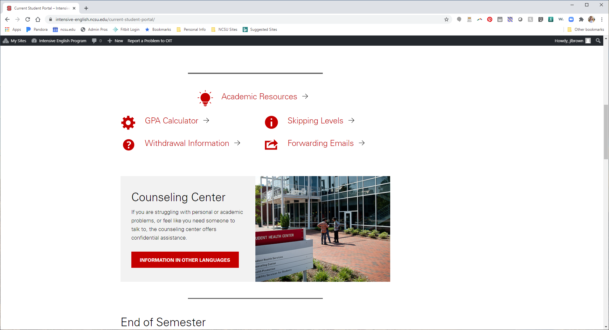
The GPA Calculator
Download the GPA Calculator from the IEP website (intensive-english.ncsu.edu)
Notes:
Now that you understand how your grade point average is calculated, let’s take a look at the GPA Calculator on the IEP website. Go to intensive dash english dot ncsu dot edu, then login to the Current Student portal. In the current student portal, you will find a GPA calculator that you can download to your computer, laptop, tablet, or phone so you can calculate your GPA at any time during the semester.

Slide 9
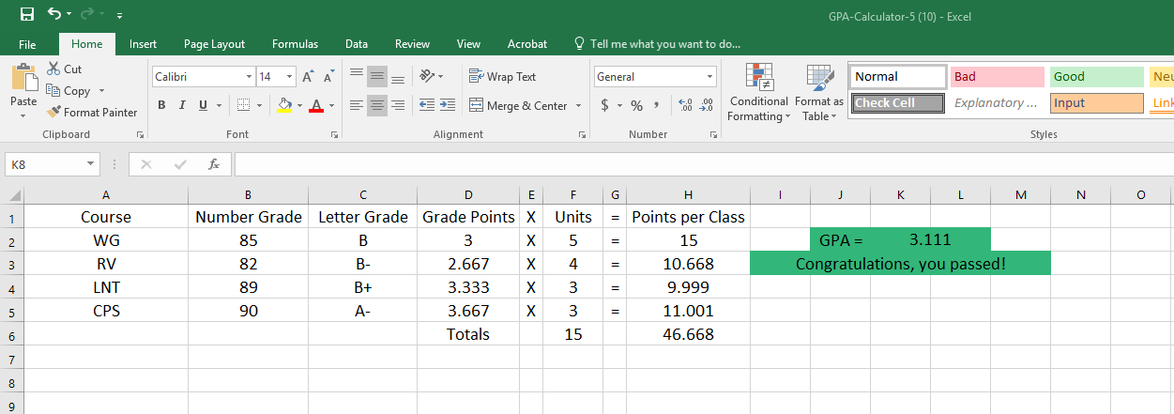
The GPA Calculator
Enter your number grades for each class and the GPA Calculator will do the math for you!
Notes:
In the GPA Calculator, enter your number grades in column B and the calculator will do all the math for you. It is very easy!

Slide 10
Thank You!
Notes:
I hope this presentation was helpful for you. If you still have questions about your GPA, speak with one of your instructors or an IEP staff member.

